Slide 1



Active Directory Auditing for
CMMC Compliance
(Applied Research Associates, Inc.)
1
CHRISTOPHER KYRIACOU | JAMIE SUTTON | NATHAN CHONG | SAFEE GHAFOORI | DAVE FULLER
Alpha Team 4 03/24/21 IT 493-004
Notes:
Welcome everyone

Slide 2
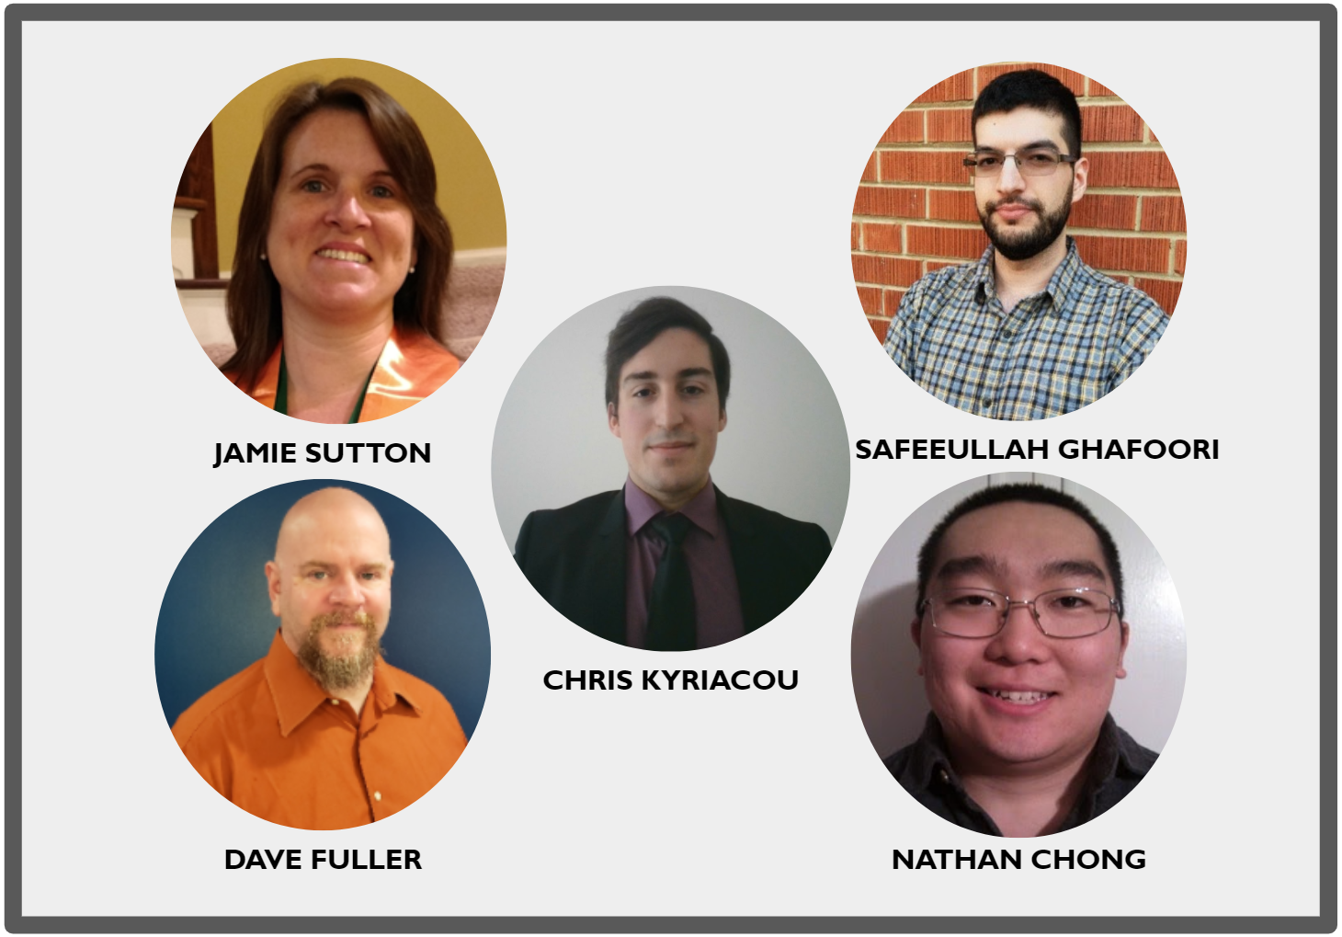
Alpha Team 4
2
Alpha Team 4 03/24/21 IT 493-004

Slide 3
IT-493 Spring 2021 Project Schedule (Still needs Edits)
3
December 2020
January
February
March
April
04
W2
18
25
W1
W2
W3
25
W1
W2
18
W4
03
W2
W3
W4
07
W2
22
28
Tool Training
Automation Research and Planning
Design Phase
Test and Debug-1
Prototype
Implementation
Training
Alpha Team 4 04/24/21 IT 493-004

Slide 4
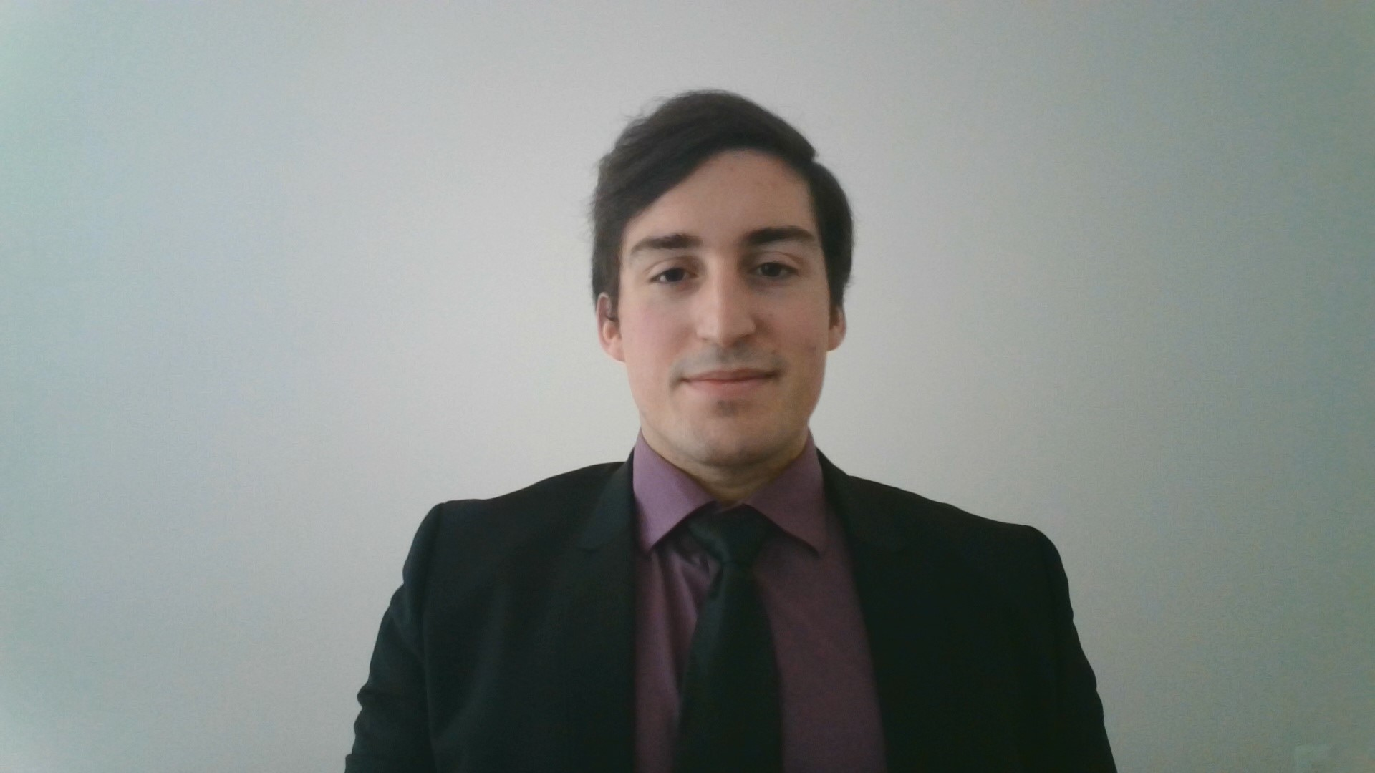
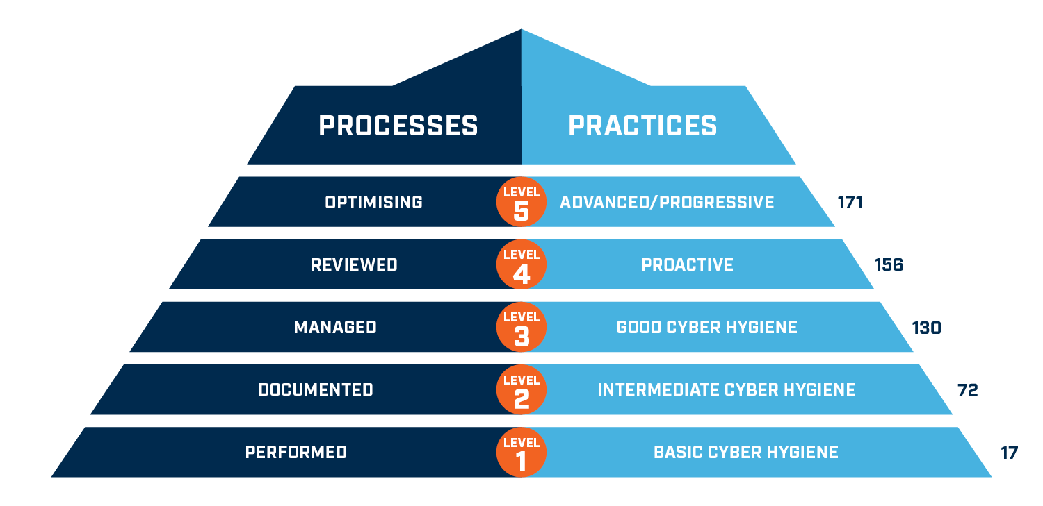
CMMC Compliance
4
Cybersecurity Maturity Model Certification
Primary Goal: Safeguard controlled unclassified information (CUI) across the DoD supply chain.
CUI: Any information or data created or possessed by the government or another entity on the government’s behalf.
Levels:
1. Addressing FAR 52.204-21 cybersecurity principles.
2. Build on CMMC Level 1 and addresses a little over half on NIST 800-171 controls.
3. Build on CMMC Level 2 and addresses all NIST 800-171 controls.
4 & 5. Build off CMMC Level 3 and include controls from a range of frameworks:
CERT RMM v1.2, NIST SP 800-53, NIST SP 800-172, ISO 27002, CIS CSC 7.1, Unattributed CMMC references
Alpha Team 4 03/24/21 IT 493-004

Slide 5

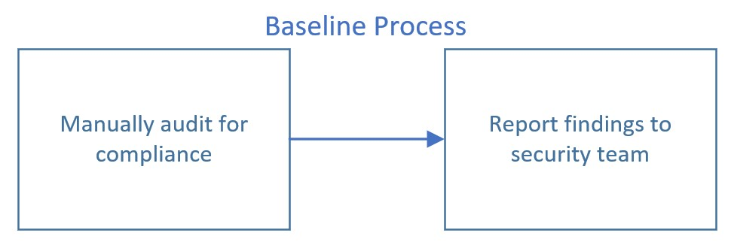
Original Business Process
5
Original Process Workflow
Quantification
Auditing for: CMMC Level 2 Compliance
Time required to conduct manual audit: 10 to 30 hours
Frequency of audits: Monthly
Salary for IT Admin to conduct audit: $83,510 per year * 2 Admins = $167,020 per year*
ARA Chief of Security directs admin at all 13 branches to follow this business process:
5
Alpha Team 4 03/24/21 IT 493-004

Slide 6
Original Business Process
6
Business Case for Change for
Automated Auditing System
Important future & current contracts will require CMMC Level 3 and up
Could be required for between 10-30% of new contracts in next 2-5 years
Reduce the hours needed to audit ARA’s servers across all 13 divisions
Can take days and even weeks
Automated audits could be conducted daily
Increase confidence in information stored within Active Directory Servers
For both ARA and Gov. Clients (DoD, DHS, etc.)
6
Alpha Team 4 03/24/21 IT 493-004

Slide 7
Original Business Process
7
Solution Implementation Challenges
7
Fully remote contact with client
No access to client AD servers or client network
Implementation must be done through client and not directly
Assumptions made about shared technical knowledge
Communication interruptions with client
Service Account Integration
7
Alpha Team 4 03/24/21 IT 493-004

Slide 8
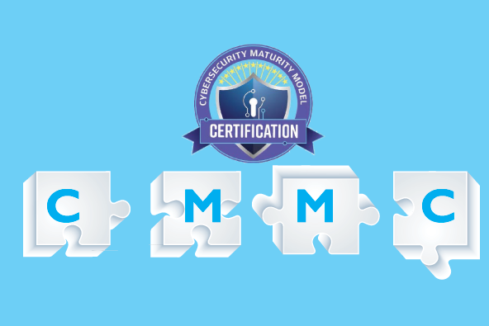
IT Solution
Auditing Active Directory for CMMC Level 3
8
Main Objective: Create an auditing system that can audit AD servers to ensure CMMC Level 3 Compliance.
Must be open source and not rely on proprietary software
Must be automatable (Using Ansible, etc.)
Must be reliable & efficient
Must be easily maintained
Must be scalable & expandable (Eventually for Level 4 & 5)
Must meet core functionality required by the client
Alpha Team 4 03/24/21 IT 493-004

Slide 9
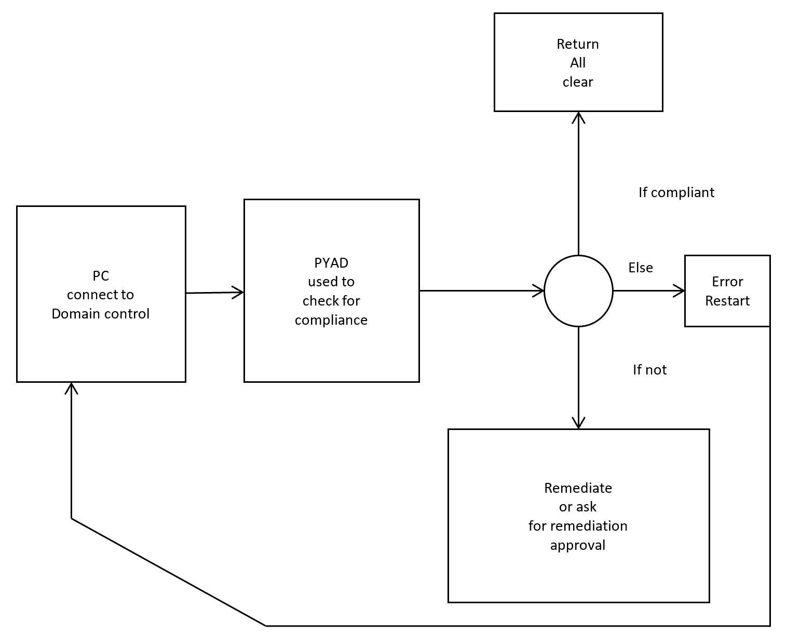
IT Solution
Desired Result
9
Functions using pyad 0.6.0
to query for info
Info passed to check if
remediation is necessary
Take appropriate action based on findings or issues that occurred
Perform in minutes
Alpha Team 4 03/24/21 IT 493-004

Slide 10
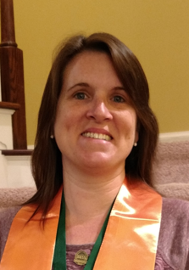

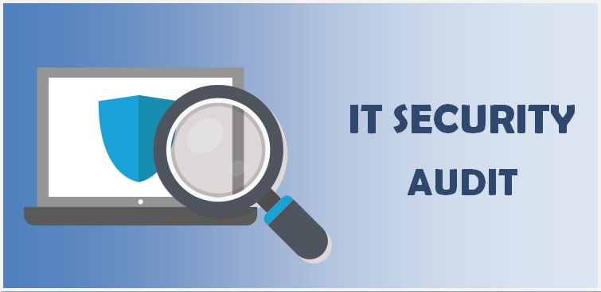
Mapping changed business
process to solution requirements
Changed Business Process
10
Changed Business Process:
Python scripts now automatically audit for compliance and generate audit report
Solution Requirements:
Create an auditing system that allows authorized security admin to audit their active directory servers for CMMC compliance and generate an audit report.
Alpha Team 4 03/24/21 IT 493-004

Slide 11
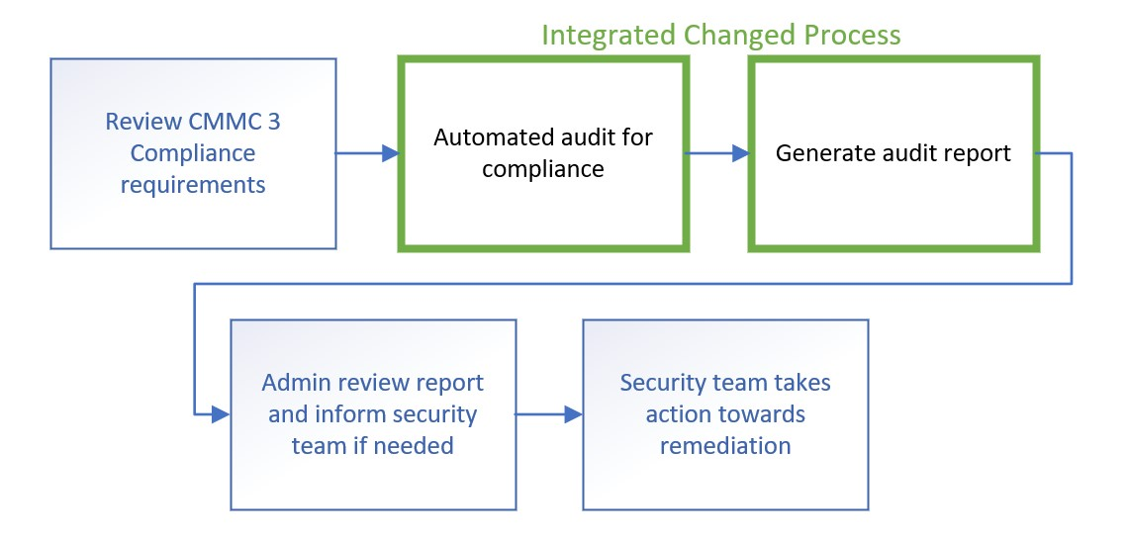
Changed Business Process
Overall Business Process
with the Integrated Changed Process
11
11
Alpha Team 4 03/24/21 IT 493-004

Slide 12
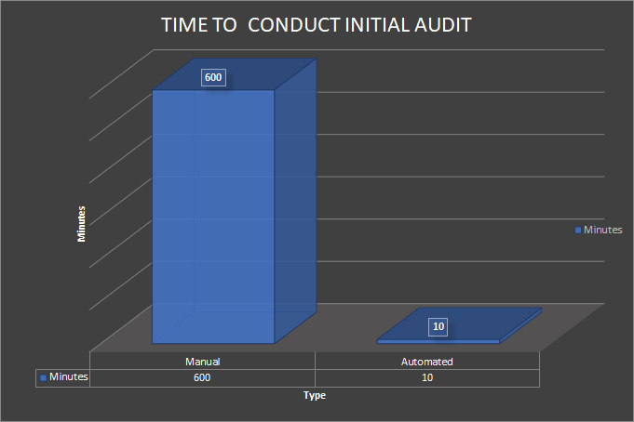
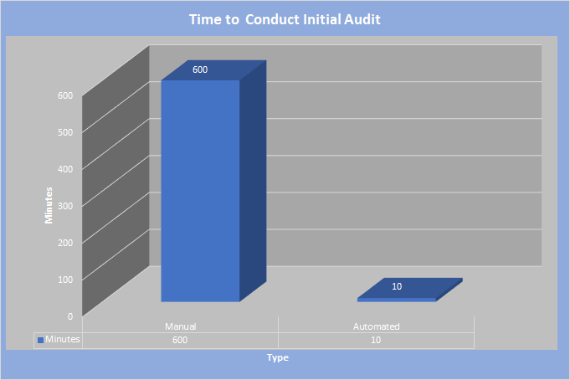
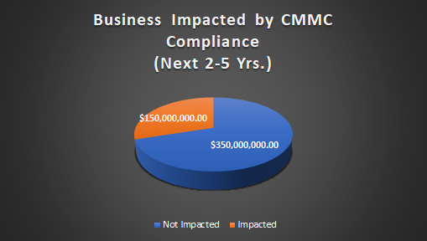
Changed Business Process
Tangible & Intangible costs
Intangible Costs:
Increase performance efficiency: Daily audit
Refocus labor
Sustain company reputation
Achieve & sustain CMMC level 3
Tangible Costs:
Save on labor: $3,060 to $12,660 yearly (Per admin)
Time saved: 76.5 to 316.5 hrs yearly (Per admin)
Implementation costs: $0.00 (Open Source)
Maintenance: Client employs proper personnel
Notes:
Note to the class (but don’t write this on the slide) that the amount of security admin will likely grow as the company is growing very fast. This means that overall labor costs will increase.

Slide 13

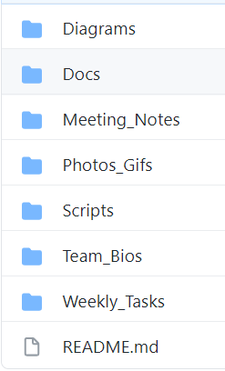
Documentation
Solution Implementable
13
Documentation was performed through a private GitHub repository
Organized documentation into sections including:
Diagrams (graphs and other visual displays)
Docs (personal documents from team members)
Meeting_Notes (team meeting notes)
Photos_Gifs (all team member photos and gifs used for presentations)
Scripts (all code for our solution, including documentation for the scripts)
Team_Bios (brief bio for each team member)
Weekly_Tasks (weekly team member assignments)
Alpha Team 4 03/24/21 IT 493-004

Slide 14
Solution Sustainment
Solution Implementable
14
Our solution was designed with limited time in mind - meant for the ARA to implement the code in our script for reuse within their own systems
Aiming to give the ARA the capability to expand upon what we have achieved
Our solution is entirely open-sourced - no concern over future costs for implementation
Alpha Team 4 03/24/21 IT 493-004

Slide 15
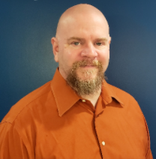
Implementation challenges addressed
(Added a way of addressing the challenges for you to work with - Chris)
Solution to challenges:
Remote contact: Regular meetings every 2 weeks & Github
No access to client server(s): Created synonymous vm environment
Shared knowledge constraints: Well documented instructions on processes
Service Account Integration: Audit system can audit any service account setup

Slide 16
CMMC -3
Important future & current contracts will require CMMC Level 3 and up
Could be required for between 10-30% of new contracts in next 2-5 years
Reduce the hours needed to audit ARA’s servers across all 13 divisions
Can take days and even weeks
Increase frequency of scans
From monthly to daily

Slide 17

Presentation

Slide 18

Questions?
18
Alpha Team 4 03/24/21 IT 493-004

